Slide 1
A Study of Amsterdam’s Airbnb Rentals
By Hiya Gaine
Apr 2020

Slide 2
Business Problem
An attempt to answer the following questions for Amsterdam’s airbnb hosts and travelers:
What are the factors that drive the listing price?
How to maximize the revenue earned from a rental?
What are the factors that drive the popularity of a vacation home?
How to increase the popularity of a rental?
When are airbnbs most likely to be available?

Slide 3
Data Sources
Foursquare API
Venue Categories - Hierarchical list of categories applied to venues
Venue Search - List of venues near the current location
Publicly available Airbnb listing data:
Information and metrics for listings in Amsterdam
Detailed Calendar Data for listings in Amsterdam
GeoJSON file of neighbourhoods of Amsterdam

Slide 4
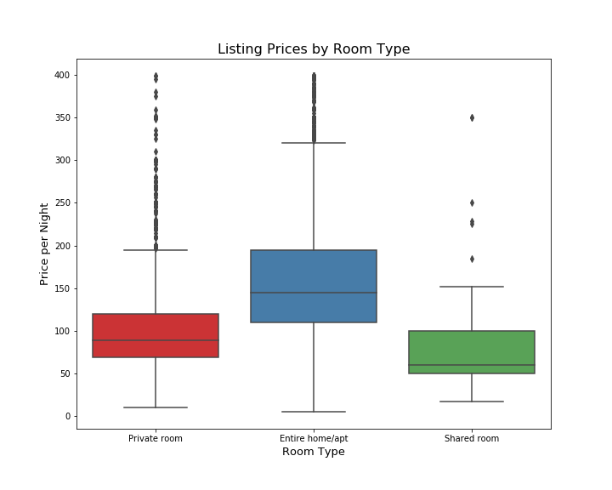
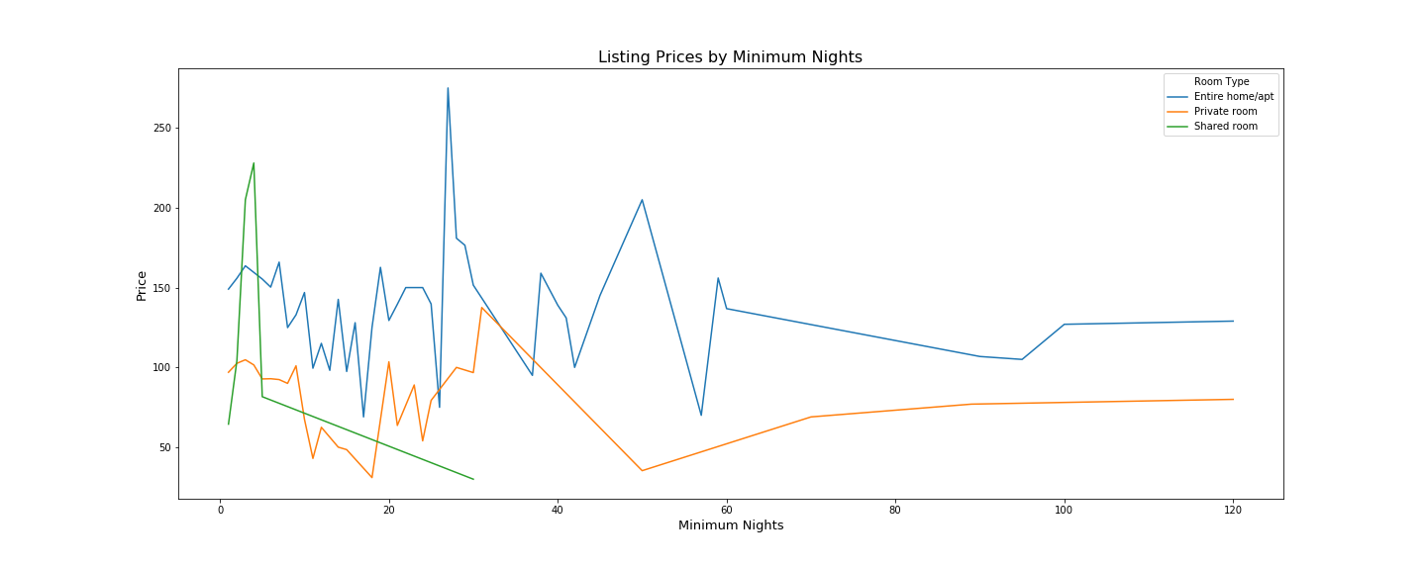
Price Analysis room type and Minimum stay
median price of entire house/apt listings are almost USD 150/night
median price of private rooms are around USD 80/night
median price of shared romms are around USD 60/night.

Slide 5
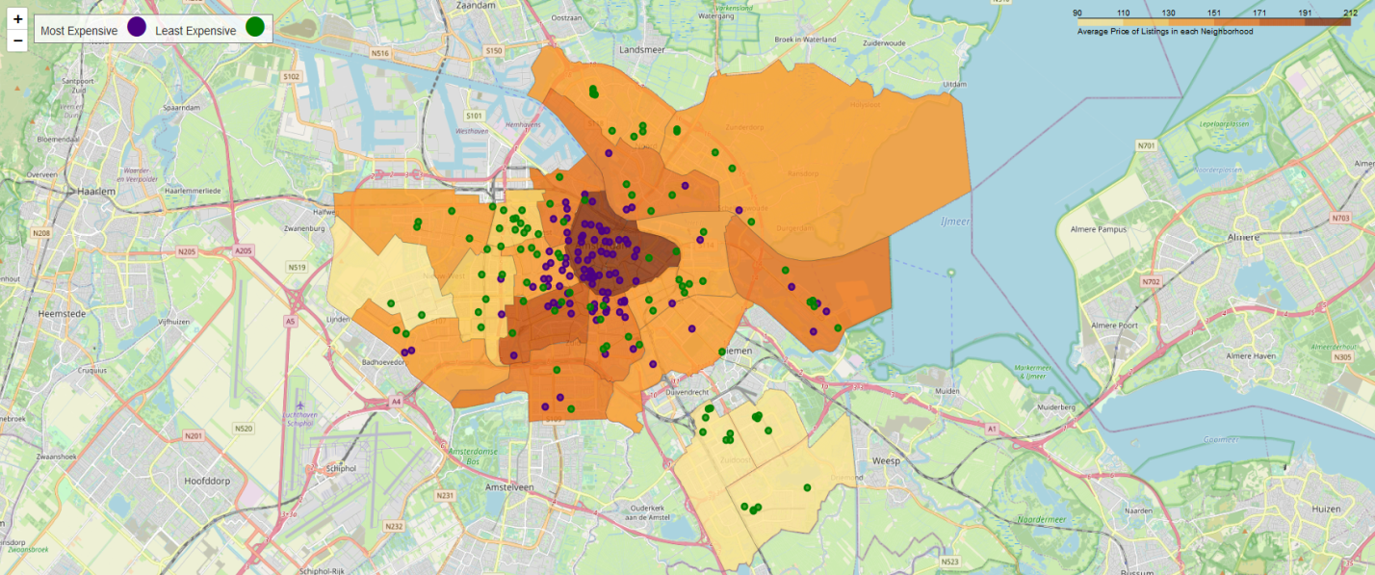
Price Analysis LOCAtion
Most Expensive Neighborhood:
Centrum-Oost
Centrum-West
Least Expensive Neighborhood:
Bijlmer-Centrum
Bijlmer-Oost

Slide 6
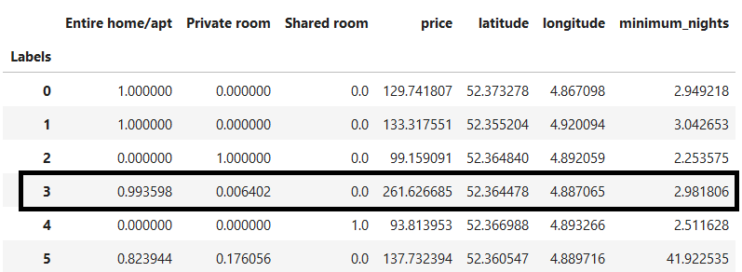
PRICE ANALYSIS RESULTS
Clustering Technique: k-means
Number of Clusters: 6
Features: Room Type, Location, Minimum Nights, Price
Highest priced cluster

Slide 7
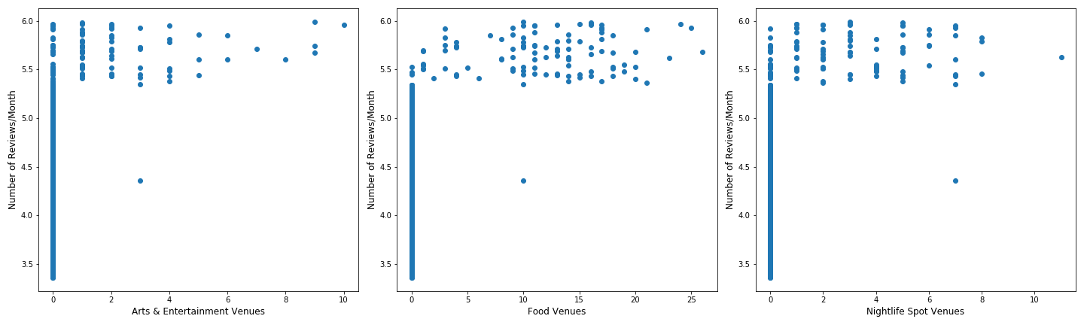
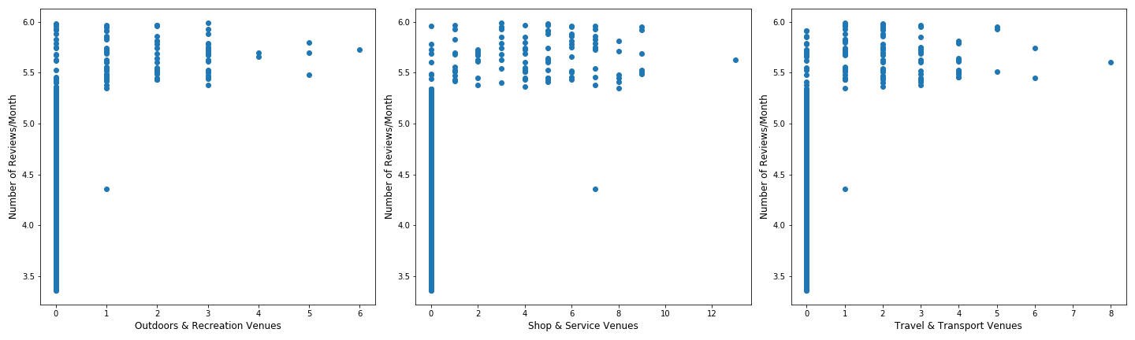
Popularity Analysis Nearby VENUES

Slide 8
Popularity Analysis RESULTS
Classification Technique: k-nearest neighbor
Number of neighbors: 2
Jaccard Index = 0.8562
F1-score = 0.8335
Confusion Matrix:
 | Actual Positive | Actual Negative
Predicted Positive | 17 | 23
Predicted Negative | 0 | 120

Slide 9
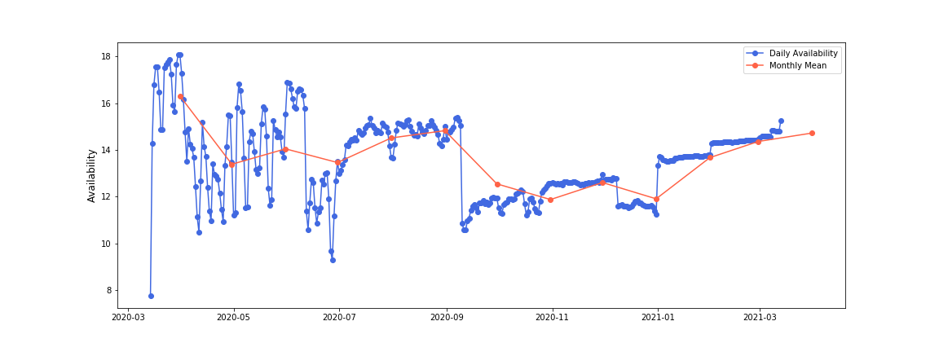
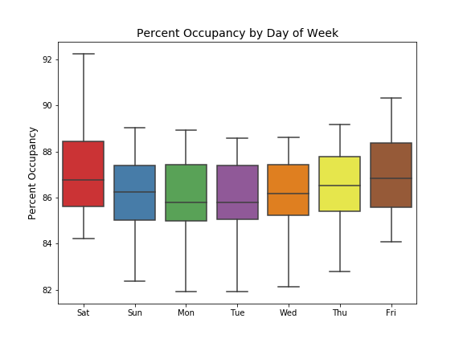
Availability Analysis
Availability by Month over next year
Highest Availability – September 2020
Lowest Availability – January 2021
Occupancy by Day of Week
Highest Occupancy – Saturday
Lowest Occupancy – Monday, Tuesday

Slide 10
CONCLUSION
This study should help:
Potential airbnb hosts to project the revenue they can expect from their listing
Existing hosts to maximize their profits and get some valuable inputs
Tourists looking to book short term rentals should also get a fair idea of when they are most likely to get accommodation

